Slide 1
Analysis of Publications on Applications of Blockchain Technology
INSE 6120: Cryptographic protocols and Network Security
Presented to: Professor Ivan Pustogarov
Presented By:
Mirza Aliva Salvin 40198142
Md. Aminul Islam 40203451
Saif Manjar Ahmad 40217056
Taufiq Al-Din 40217260
Kareem Shamayleh 40222388

Slide 2
Introduction

Slide 3
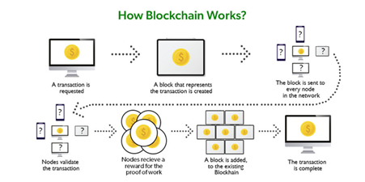
Blockchain Mechanism
Blockchain is a distributed ledger that keeps records of transactions in a way that is both immutable and visible.
Each block in the chain includes a cryptographic hash of the prior block, making for a secure and unalterable ledger of all past transactions.
As a new block is added to the blockchain, a notification is sent out throughout the network and every node updates its own blockchain to reflect the change.
Types of blockchain mechanisms:
Proof-Of-Work (POW)
Proof-Of-Stake (POS)
Delegated Proof-Of-Stake (DPOS)

Slide 4
Blockchain and the Military

Slide 5
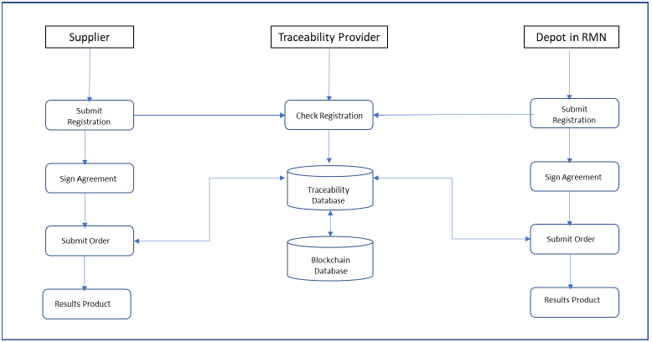
Military Blockchain for Supply Chain Management Review
SCM(Supply chain management) is a system in which we ensure the transportation of raw materials from a supplier until it is delivered to the end customer as a final product. In the middle of it all the raw materials have been presumably processed into parts and those parts put together to create the final product.
Issues pertaining to modern SCMs:
Counterfeiting.
Failure to find source of error.
Missing parts.
Lost shipments.
Blockchain would address these issues due to its ledger format, there will be a certain traceability to any error or mistake that has happened so we can trace the error back to its source and fix it accordingly.
Proposed application would be in the Navy and the Navy SCM

Slide 6
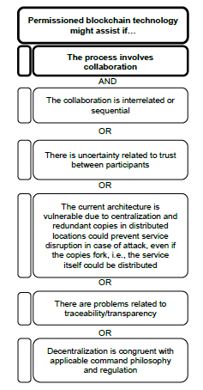
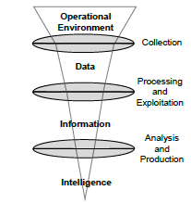
Military Intelligence Applications for Blockchain Technology Review
Intelligence is the core of all operations within the military and the decisions made from data gathered through intelligence is what shapes the state of the military. Thus, the collection, analysis, and exploitation all need to be efficient and effective to help create a better situation for a decision to be made.
Potential Applications:
Big Data
Distributed and decentralized access
Ethical Accountability

Slide 7
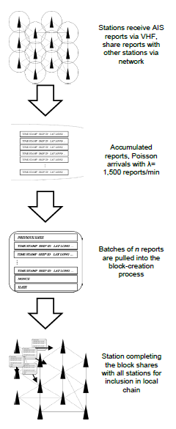
Military Intelligence Applications for Blockchain Technology Review
Proposed Design:
A more specific design would be the proposed blockchain application to the AIS or Automated Identification System, this is a system used by the nautical branch of the military to keep track of all ships deployed within a given area. The system is very similar to cryptocurrency systems in which individuals within the system do not necessarily trust each other but they all have to cooperatively participate.
The system would involve the AIS station receiving ship reports through radio, accumulating the reports with a frequency of over 1500 reports per minute and adding them to a block-creation process, afterwards the station would broadcast the changes it received to all other stations within its network.

Slide 8
Blockchain and IOT

Slide 9
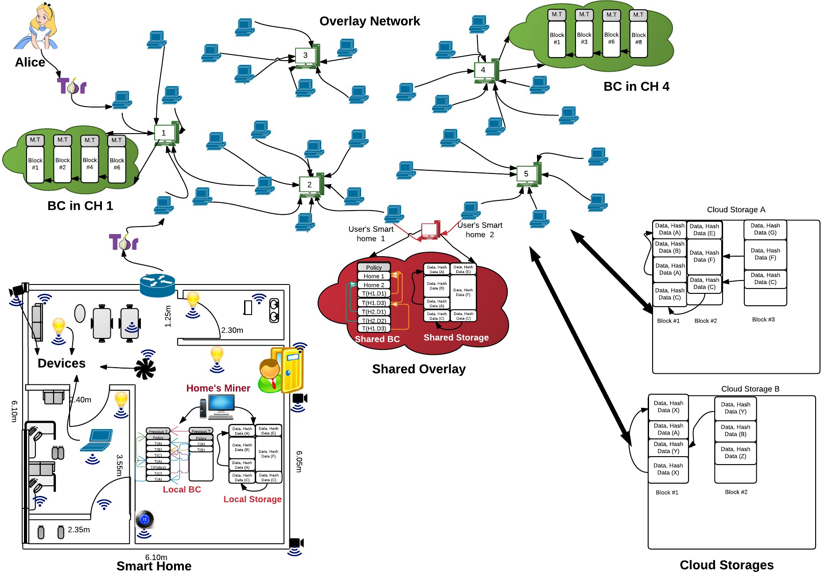
Blockchain Based IOT
Architecture:
Device: router, sensors, cameras etc.
Local BC & Storage:
Home computer (local BC) is used and controller by home owner to manage and monitor connected devices (security & privacy)
They generate secret key pairs (Diffie-Hellman) to enable communication between devices
Overlay Network:
Network consists of multiple nodes, organized into cluster with CH(cluster head) to maintain legitimate device lists
Reduced synchronization cost(multiple BC in single CH) but longer delay to find specific block

Slide 10
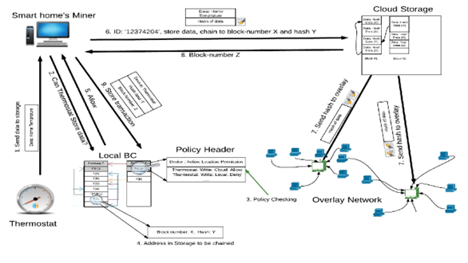
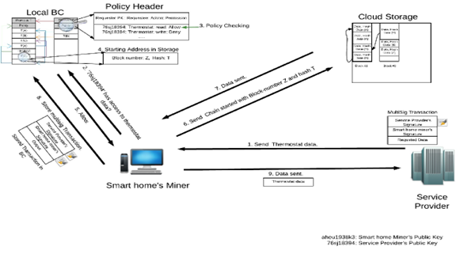
Blockchain Based IOT
Cloud Storage:
Hash and block number encrypted via Diffie-Hellman to ensure authentic data delivery to third party services
Transaction Handling
Storing:
Data sent to local miner that verifies policy and miner sends hash & block of data to corresponding storage ( cloud, local ) to ensure all parties are aware of its inclusion to maintain trust
Accessing :
multi-signature( signed by both provider and miner ) is created and verified by local BC.
Miner transmits the data to requester to encrypting with SP’s public key.
Distributed Trust: using Beta Reputation System (direct and indirect trust level), CH maintains trust
CH’s verifies(multi-sig) either random portion or full block

Slide 11
Preventions of attacks
DOS attack prevention:
Using primary key the CH blocks unauthorized access
Modification attack prevention:
Hash of data between different entity ( cloud, local storage ) are compared to detect any unauthorized modification
Dropping attack prevention:
when compromised CH deletes all incoming request, other nodes on same cluster notice this activity and choose new CH
Mining attack prevention:
Fake block inclusion prevention is done by CH validating transactions on blocks
Anonymity attack prevention:
Overlay network is used to protect user anonymity ( transactions not recorded on public server)
Authentication and access control attack prevention:
Unauthorized addition of devices are prevented by pre-registering the devices by device owner.

Slide 12
Blockchain and Video Games

Slide 13

Use cases of blockchain in gaming
Crypto-collectibles
Blockchain-based marketplaces
Decentralized gaming platforms
Anti-cheat mechanisms

Slide 14

Challenges and limitations of blockchain in gaming
Scalability
High transaction fees
Complexity of implementation
User experience
Adoption

Slide 15
Blockchain in NFTs

Slide 16
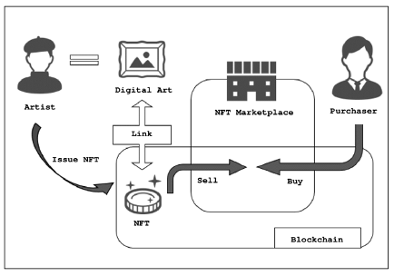
NFT Mechanism
Advantages of using NFT
Applications of NFT
Key Challenges of NFT
Mitigation for these issues
Future of NFT
Figure : How NFTs work

Slide 17
NFT PAPER REVIEWs
1 : A review of the key challenges of non-fungible tokens
Reviewed 42 articles
Classified challenges in 7 categories :
Usability Challenges
Privacy Issues
Governance Consideration
Security Issues
Extensibility Issues
Environmental Impact
Intellectual Property Issues
2 : Blockchain technology for creative industries: Current state and research opportunities
Moved through heritage phases and into exploration, with a persistent drive for exploitation.
Generated disruption across a wide range of markets, including fine arts, sports, law, escrow, tickets, digital collectibles, gaming, and crypto-technical sectors.
Have the potential to disrupt several industries and have already facilitated the birth of new marketplaces.

Slide 18
Blockchain in Banking

Slide 19
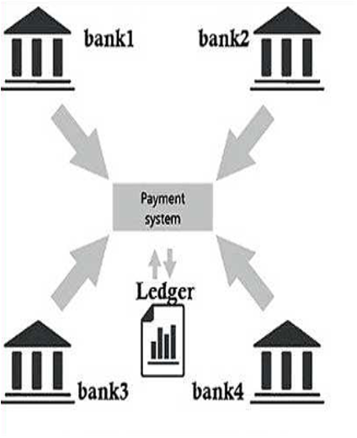
Traditional Banking System
Banking:
Important to an Economy’s Smooth Operation
Make Purchases, Withdraw Cash & Loan activity.
Online Banking
Traditional Banking:
Foundation of the Global Financial System for Business and Economy.
Centralized database (Security and Integrity).
All Banks Work with Central Electronic Ledger.

Slide 20

Challenges of Traditional Banking System
Main Challenges of Traditional Banking:
Inefficiency
Transparency Issue
Limited Accessibility
Centralization Issue
Security Issue
Intermediaries
Costs
Lack of Innovation

Slide 21
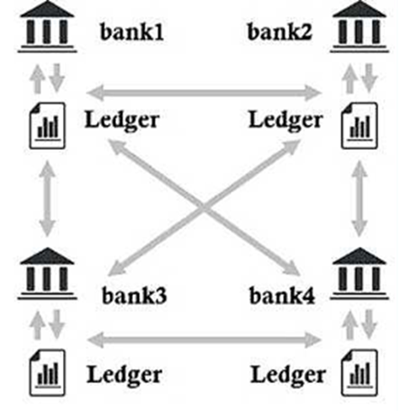
Use of Blockchain in Banking
Blockchain in Banking
Decentralized and Distributed Digital Ledger
Consortium Blockchain

Slide 22
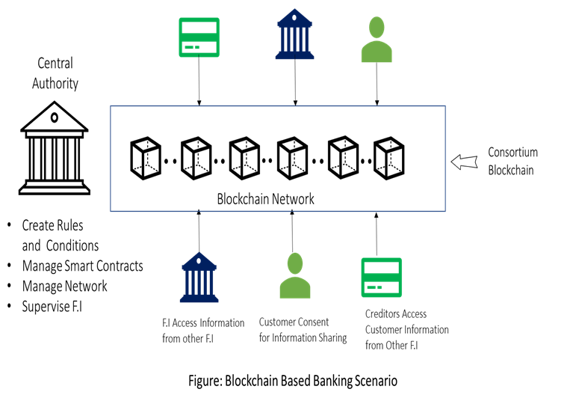
Blockchain Based Banking
Blockchain Based Banking
Making a Blockchain Network
Digital wallet creation
Initiating Transactions
Recording Transactions
Settlement
Regulation and compliance

Slide 23

Key Features of Blockchain in Banking
Key Features of Blockchain based Banking
No Centralized Authority or intermediary to Facilitate Transactions
Secure and Faster International Money Transfer
Reducing Operational Risks and Enabling Real-time
Streamlined Credit Prediction and Credit Scoring
Less Operational Cost for Banks and Customers
Low Chance of Processing Error
Easier Lending and Borrowing Operations

Slide 24

Security Impacts of Blockchain
Security Impact Of Blockchain Technology With Existing Systems:
Man-in-the-middle attacks
Central Server Hacking
DDoS attacks
Race condition attacks
Malicious hubs
Sybil attacks
Replay attacks
Front-running attacks
Routing attacks
.

Slide 25

Challenges of This Survey
Challenges of This Survey:
There was very little research done before with all the application fields together to put in one study.
No research has mentioned the main changes in existing system that has been brought by blockchain technology.
Studied many research papers, articles and blogs to gather all fields.
.

Slide 26

Conclusion
In this survey project we have focused heavily on several sectors of the industry, namely Military, IoT, Video Games, Non-Fungible Tokens(NFTs), and Banking regarding the adoption of Blockchain Technology.
Blockchain is the technology that is being adopted into the different domains of several industries which ensuring transparency, decentralization, reduced costs of business, enhanced security, fraud control.
.

Slide 27
References
[1] https://www.geeksforgeeks.org/how-does-the-blockchain-work/
[2] Rahayu, Syarifah Bahiyah, et al. Military Blockchain for Supply Chain Management - JESOC.https://www.jesoc.com/wp-content/uploads/2019/08/KC13_015.pdf.
[3] M. McAbee, Ashley S., et al. Military Intelligence Applications for Blockchain Technology. https://pdfs.semanticscholar.org/4db1/edd97c5867ced07692e4c1e277c0fa3205ae.pdf.
[4] https://www.bbc.com/news/business-44341490
[5] Ali Dorri, Salil S. Kanhere, and Raja Jurdak, “Blockchain in Internet of Things: Challenges and Solutions”
[6] Volkan Dedeoglu, Raja Jurdak, Guntur D. Putra, “A Trust Architecture for Blockchain in IoT”
[7] Salil S. Kanhere, Raja Jurdaky and Praveen Gauravaram, “Blockchain for IoT Security and Privacy: The Case Study of a Smart Home”
[8] Raja Jurdak, Ali Dorri, Salil S. Kanhere “Towards an Optimized BlockChain for IoT”.
[9] K. Anderton, “The business of video games: Market share for gaming platforms in 2019 [infographic]”. Jun 2019. [Online].Available: https://www.forbes.com/sites/kevinanderton/2019/06/26/the business-of-video-games-market-share-for-gaming-platforms-in-2019- infographic/6f39edfe7b25
[10]C. Gough, “Number of gamers worldwide 2021 Aug 2019.[Online].Available: https://www.statista.com/statistics/748044/number video-gamers-world/
.

Slide 28
References
[11]V. Buterin “Ethereum: A next-generation smart contract and decentralised application platform”, Dec 2014
[12]W. Entriken and D. Shirley, “Eip 721: Erc-721 nonfungible token standard”,” Jan 2018.[Online].Available: https://eips.ethereum.org/EIPS/eip-721
[13]V. Buterin and F. Vogelsteller Eip 20: Erc-20 token standard, Nov 2015. [Online]. Available: https://eips.ethereum.org/EIPS/eip-20
[14] W. Radomski, A. Cooke, and P. Castongua Eip 1155: Erc 1155 multi token standard, ,” Jun 2018. [Online]. Available: https://eips.ethereum.org/EIPS/eip-1155 2020 Second International Conference on Blockchain Computing and Applications (BCCA)
[15]https://ethereum.org/en/nft/
[16]https://www.toprankedlegal.com/nft-mechanism-and-legal-issues-of-nft-transactions/
[17]https://www.analyticsinsight.net/nfts-basics-examples-uses-and-benefits/
[18]https://aws.amazon.com/blockchain/nfts-explained/
[19]https://news.bloomberglaw.com/ip-law/the-trendy-hot-nft-market-has-a-new-entrant-patents
[20]https://thegivingblock.com/resources/what-is-nft-fundraising/
.

Slide 29
References
[21]Omar Ali, Mujtaba Momin, Anup Shrestha, Ronnie Das, Fadia Alhajj, Yogesh K. Dwivedi, A review of the key challenges of non-fungible tokens, Technological Forecasting and Social Change, Volume 187, 2023, 122248, ISSN 0040-1625, https://doi.org/10.1016/j.techfore.2022.122248.
[22]https://www.sciencedirect.com/science/article/pii/S0167811622000544
[23]https://support.opensea.io/hc/en-us/articles/4408474998419
[24]https://101blockchains.com/smart-contract-security-guide/
[25]Kathleen Bridget Wilson, Adam Karg, Hadi Ghaderi, Prospecting non-fungible tokens in the digital economy: Stakeholders and ecosystem, risk and opportunity,Business Horizons,Volume 65, Issue 5,2022,Pages 657-670,ISSN 0007-6813, https://doi.org/10.1016/j.bushor.2021.10.007.
[26]Guo Y, Liang C. Blockchain application and outlook in the banking industry. Financ Innov 2: 24.
[27]Hassani H, Huang X, Silva E. Banking with blockchain-ed big data. Journal of Management Analytics. 2018 Oct 2;5(4):256-75.
[28]Isaak J, Hanna MJ. User data privacy: Facebook, Cambridge Analytica, and privacy protection. Computer. 2018 Aug 14;51(8):56-9.
[29]Su H, Jung C. Perceptual enhancement of low light images based on two-step noise suppression. IEEE Access. 2018 Jan 8;6:7005-18.
[30]https://en.wikipedia.org/wiki/History_of_banking/
[31]https://www.bing.com/images/search?q=Banking+scenario+based+on+Blockchain&form=HDRSC4&first=1
.

Slide 30

Questions & Answer
.

Slide 31

.

